Slide 1
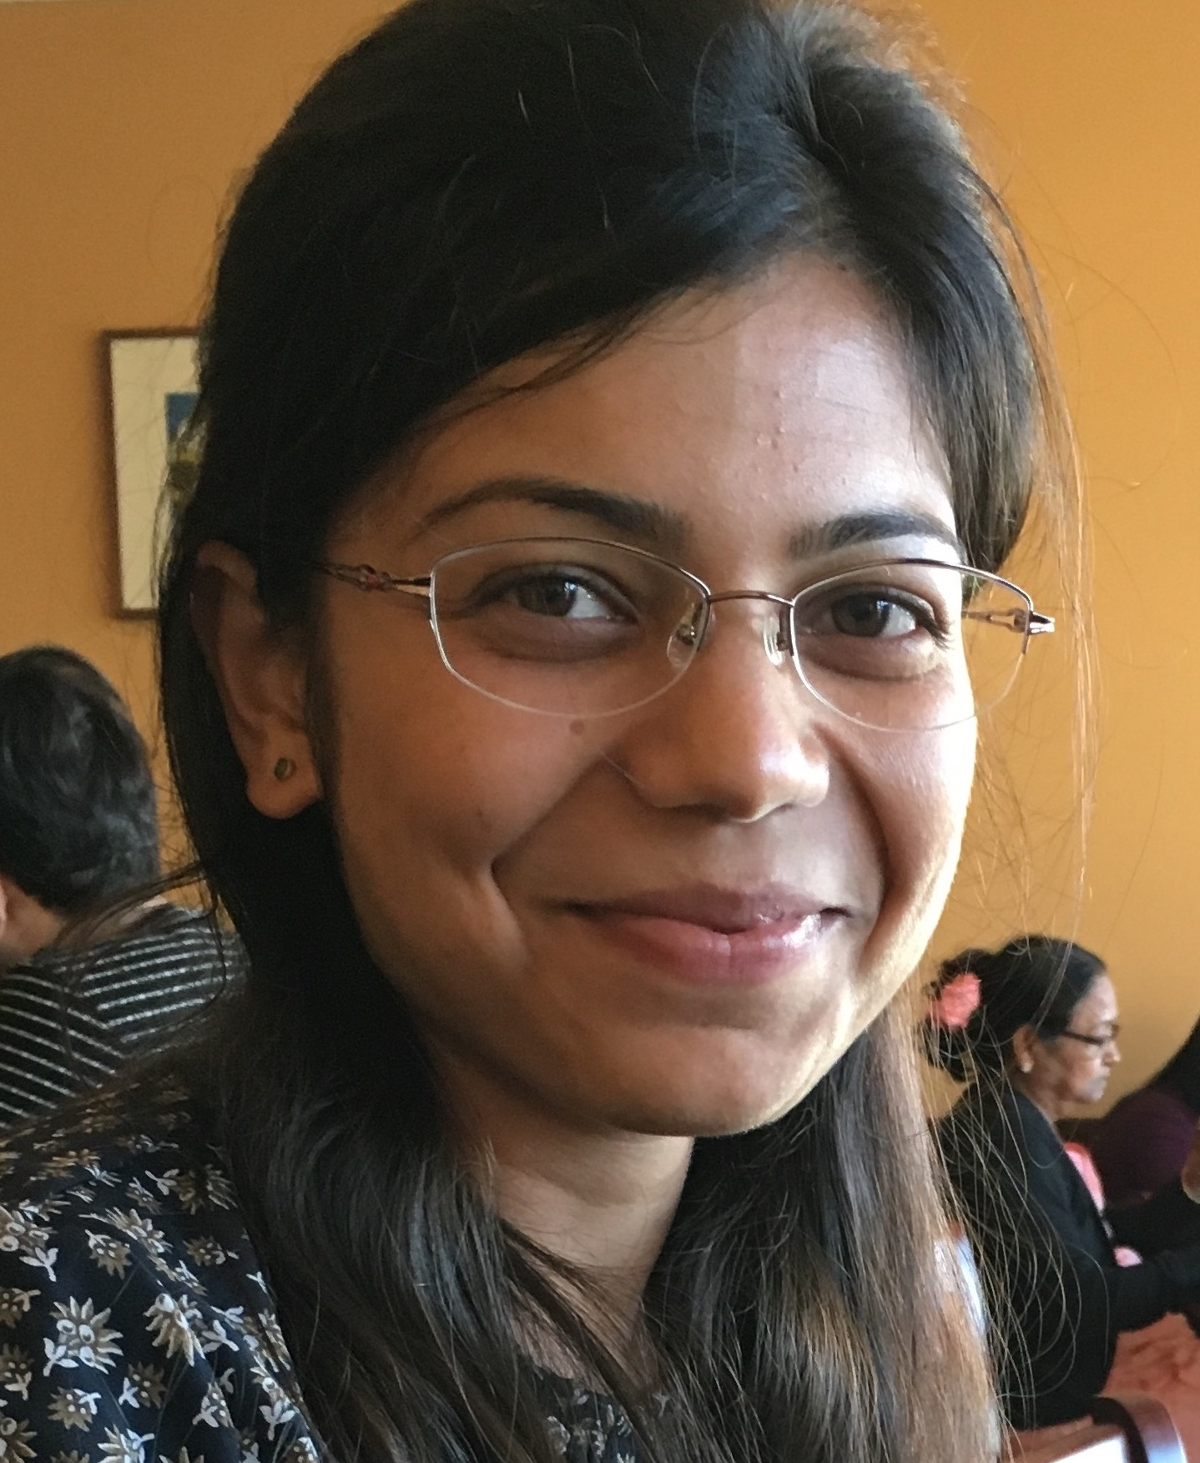
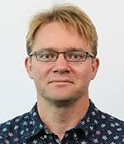
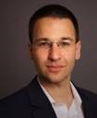
SIGCOMM 2021 Tutorial:
Traffic engineering in cloud WANs
Rachee Singh
Microsoft
Nikolaj Bjørner
Microsoft
Michael Schapira
Hebrew University of Jerusalem
1
Notes:
Welcome everyone! Thanks for coming to the tutorial on traffic engineering in cloud WANs. Nikolaj, Michael and I are very excited to share the tutorial program with you.

Slide 2
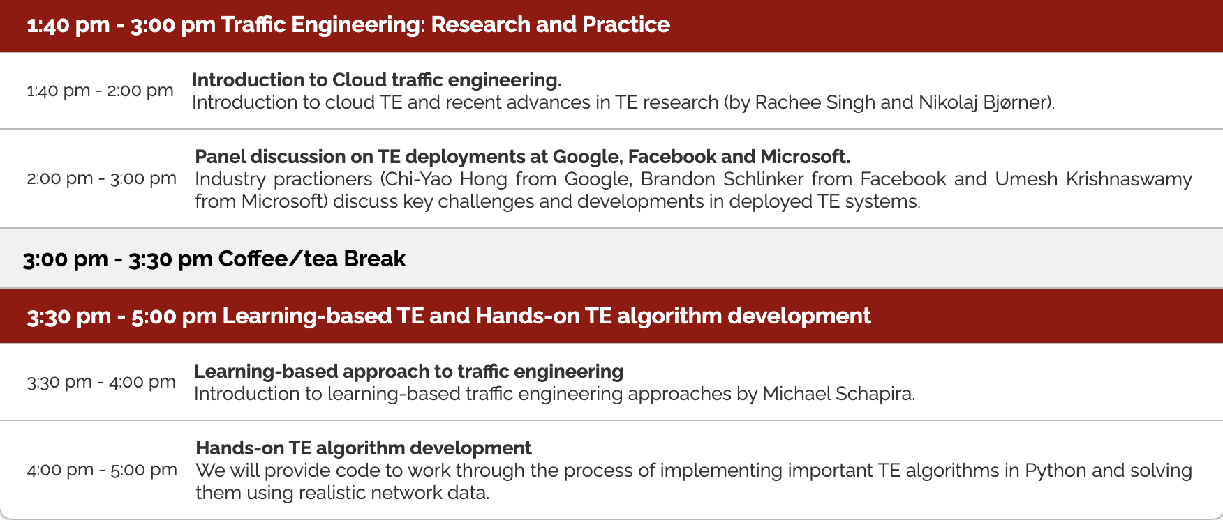
Tutorial Schedule
2
Notes:
In the tutorial, after this brief introductory talk about traffic engineering in cloud WANs, we have panel discussion on how traffic engineering is prevalent in large production WANs. Our panelists are actively involved in developing and maintaining large TE systems. I will say more about them in just a little bit.
Then there is a short break after which Michael will talk about the role of ML in traffic engineering.
And finally, we have a hands on session where we will implement state-of-the-art TE algorithms.

Slide 3
Logistics for the tutorial
The tutorial schedule is up online: https://conferences.sigcomm.org/sigcomm/2021/cloud-te-tutorial.html
Join the tutorial slack channel for discussions: https://app.slack.com/client/T0107RGGMU6/C0281SQM141
Code for the hands-on session in this repo: https://github.com/racheesingh/cloud-te-tutorial
3
Notes:
For those you might have missed the information, here are some quick things to note. The details about the tutorial and the schedule are up online on the SIGCOMM homepage. <next>
There is a Slack channel for any questions/clarifications you have. <next>
The code for the hands-on programming session along with the APIs to help quick development are available in the Github repo.

Slide 4
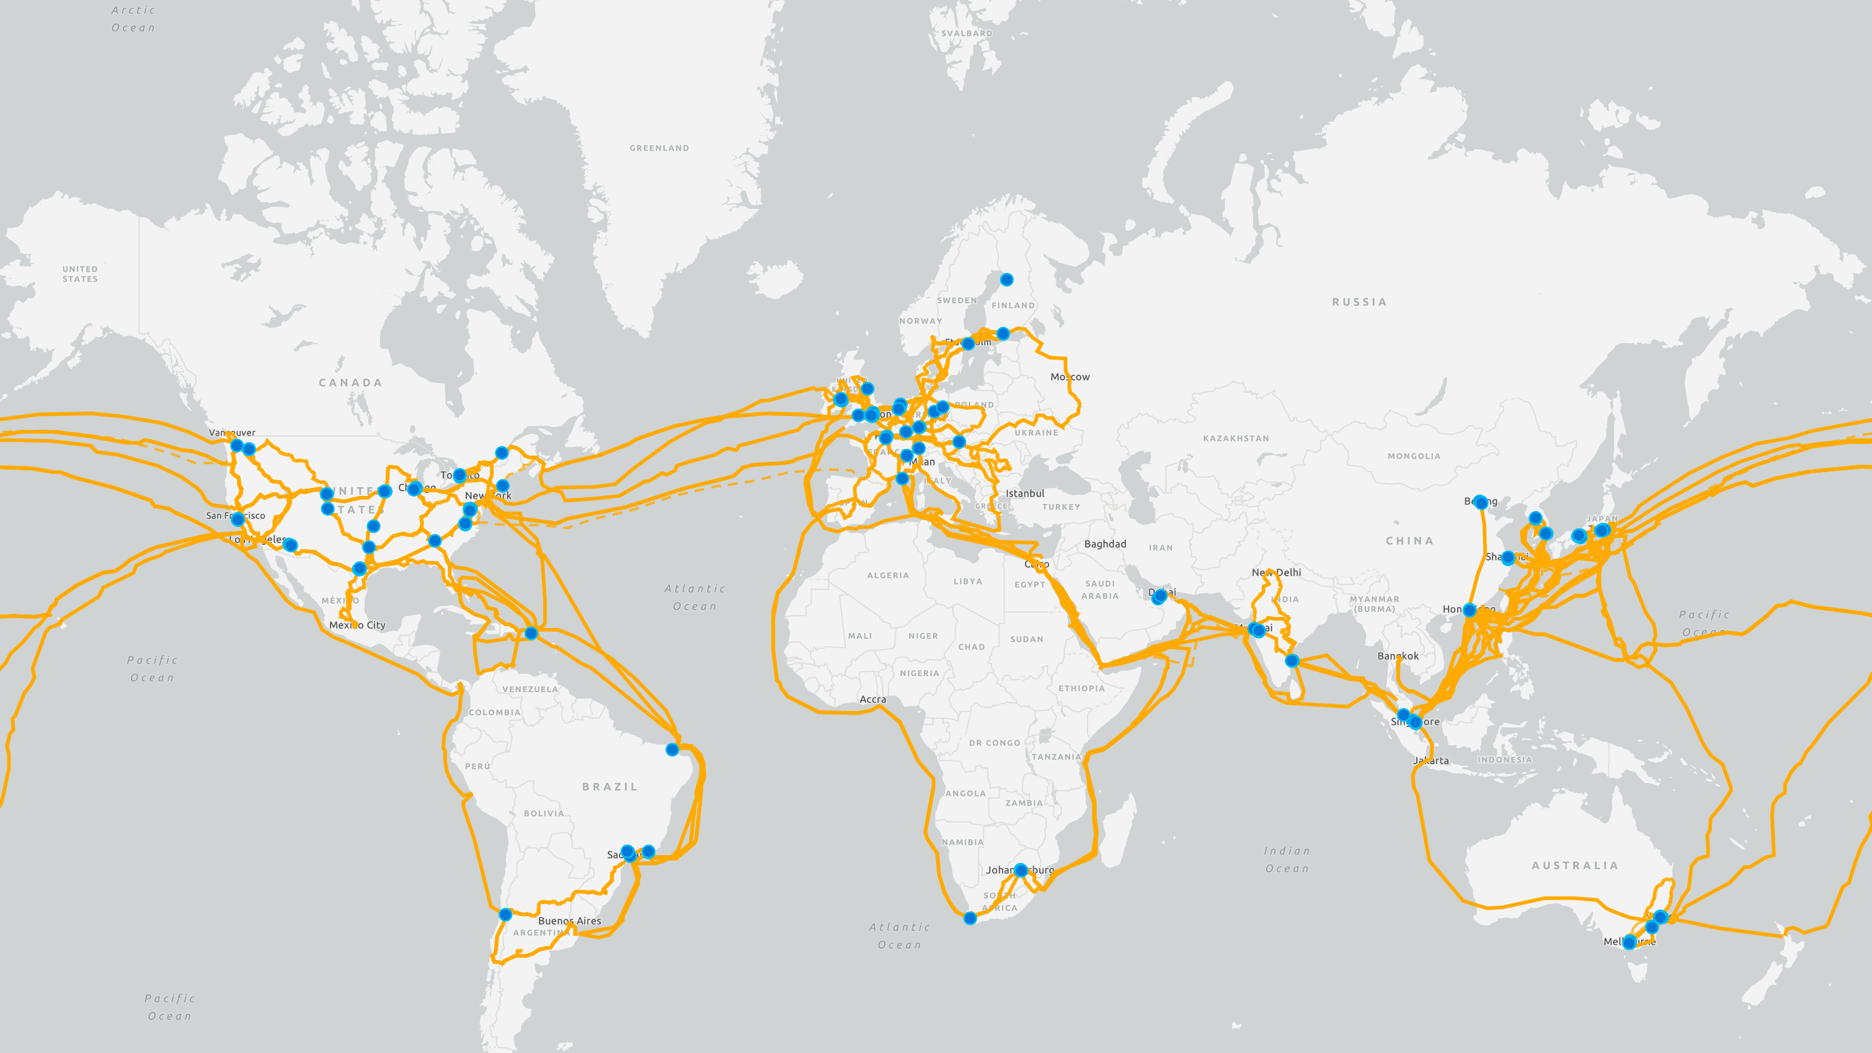
200+ datacenters
Dedicated Wide Area Network
Costs O(100) million dollars per year
Notes:
Here on the slide, I have a visualization of <next> 100s of datacenters of a large cloud provider. These are the red circles on the map. These DCs spread across the globe are connected to each other by a private network that is <next> called the Wide Area Network or the WAN.
This WAN is is critical to the business of cloud providers. It allows the cloud provider to meet the strict latency and throughput guarantees for their customer’s traffic.
The WAN consists of thousands of optical and electrical devices connected by <next> over a 100,000 miles of fiber. The yellow lines on the map represent the fiber.
<next> It takes hundreds of millions of dollars annually to operate a wide area network at this scale.

Slide 5
Design and operate efficient wide-area networks with centralized traffic engineering
5
Notes:
Due to their importance and high cost, we want to design and operate efficient wide area networks using centralized traffic engineering. And centralized traffic engineering is the focus of this tutorial.

Slide 6

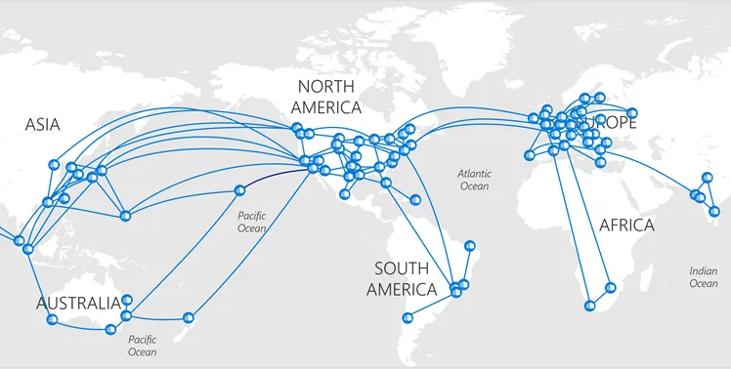
Cloud WAN traffic engineering
TE Controller
Allocate network traffic to achieve optimal flow, latency etc.
Centralized traffic engineering*
Controller periodically computes traffic allocations between datacenters
* SWAN [SIGCOMM 2013], B4 [SIGCOMM 2013]
6
Notes:
The high-level goal of traffic engineering is to allocate traffic demands They use centralized traffic engineering systems to allocate traffic along different paths or edges in these inter-regional networks. For instance, in theMSFT network, SWAN does this.
<next>
So, there is a centralized TE controller, it gauges the demands in the network and calculates the traffic/flow allocations between regions. The SWAN controller is centralized and allocates flow along different tunnels or paths between a source/destination region.
<next>
This processes occurs periodically – something like every 5 minutes, the controller gauges the new demands and computes flow allocations

Slide 7
Cloud traffic engineering research
2013
SWAN, B4
Centralized TE with max throughput
2014
FFC Tempus
Failure Resilience
2016
OWAN, Pretium
Scheduling
2017
Espresso EdgeFabric
Inter-domain TE
Development in the hands-on session
2018
RADWAN, SMORE, B4 and After
Distributed TE
2019
TeaVaR, Lancet
Failure Resilience
2021
Cascara NCFlow
Shoofly
Inter-domain TE
Distributed TE
Provisioning
Notes:
There is a rich and long history of innovations in cloud traffic engineering from both research and academia. Traffic engineering itself has been an active area of research for over two decades but I will focus on the more recent history of traffic engineering in cloud networks. I know there are several people involved in these works and I will try to bring up their pictures/names cumulatively in the slide.
<next>
This saga began in 2013 with SWAN’s publication and deployment in Azure.
<next>
SWAN implements a TE design where a central control collects information about network demands and tunnels or paths between nodes in the network. It then solves an optimization problem to maximize the network throughput by allocating demands along different paths in the network.
Soon after, the focus shifted to not just maximizing the network throughput but doing so in the presence of link failures. <next> This came in form of forward fault correction and <next> TeaVar both at SIGCOMM. <next>
The focus of these systems was to enable failure resilience in the network.
Very recently, we see an emerging trend in TE. <next> Cloud WANs have increased in size in the last decade, leading to a scale problem. To combat the scaling challenges, NCFlow <next> has proposed distributed TE.
<next>
In addition, <next> Cascara recently extended some of the TE ideas to perform inter-domain TE from the cloud with the goal of reducing bandwidth costs.
<next>
The most recent work on this timeline is Shoofly which takes the ideas of traffic engineering and applies them to the problem of network provisioning.
<next>
I know I have not added all of the pictures here because the space is small but there is a long list of wonderful collabotors who have contributed foundational work to the traffic engineering field. <next> Especially some of our wonderful collaborators in Azure networking.

Slide 8
Central themes in traffic engineering
2013
SWAN, B4
Centralized TE
One-shot
Run-time
Intra-domain TE
2014
FFC Tempus
Failure Resilience
2016
OWAN, Pretium
Scheduling
2017
Espresso EdgeFabric
Inter-domain TE
2018
RADWAN, SMORE, B4 and After
Distributed TE
2019
TeaVaR, Lancet
Failure Resilience
2021
Cascara NCFlow
Shoofly
Inter-domain TE
Distributed TE
Provisioning
Notes:
There is a rich and long history of innovations in cloud traffic engineering from both research and academia. Traffic engineering itself has been an active area of research for over two decades but I will focus on the more recent history of traffic engineering in cloud networks. I know there are several people involved in these works and I will try to bring up their pictures/names cumulatively in the slide.
<next>
This saga began in 2013 with SWAN’s publication and deployment in Azure.
<next>
SWAN implements a TE design where a central control collects information about network demands and tunnels or paths between nodes in the network. It then solves an optimization problem to maximize the network throughput by allocating demands along different paths in the network.
Soon after, the focus shifted to not just maximizing the network throughput but doing so in the presence of link failures. <next> This came in form of forward fault correction and <next> TeaVar both at SIGCOMM. <next>
The focus of these systems was to enable failure resilience in the network.
Very recently, we see an emerging trend in TE. <next> Cloud WANs have increased in size in the last decade, leading to a scale problem. To combat the scaling challenges, NCFlow <next> has proposed distributed TE.
<next>
In addition, <next> Cascara recently extended some of the TE ideas to perform inter-domain TE from the cloud with the goal of reducing bandwidth costs.
<next>
The most recent work on this timeline is Shoofly which takes the ideas of traffic engineering and applies them to the problem of network provisioning.
<next>
I know I have not added all of the pictures here because the space is small but there is a long list of wonderful collabotors who have contributed foundational work to the traffic engineering field. <next> Especially some of our wonderful collaborators in Azure networking.

Slide 9
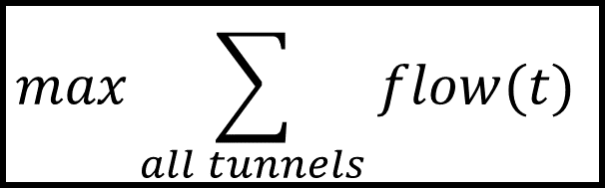
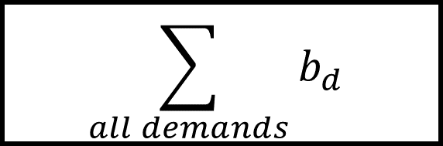
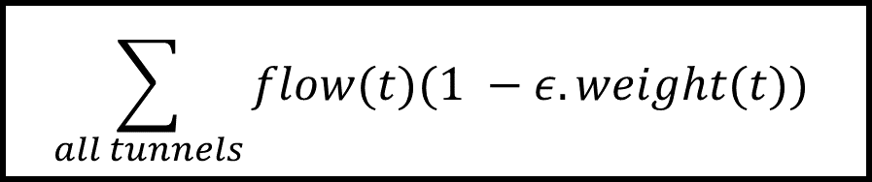
Centralized traffic engineering formulation
Inputs
Outputs
Network Topology
$$\sum_{all demands}{b_{d}}$$
Optimization
Objective
$$\sum_{all tunnels}{flow(t)(1 −ε. weight(t))}$$
Flow Allocations
Demand Matrix
$$max\sum_{all tunnels}{flow(t)}$$
Tunnels
Demand Constraints
Capacity Constraints
Flow Cons. Constraints

Slide 10
Centralized traffic engineering formulation
Static topology database
Network Topology
Bandwidth broker estimates demand matrix
Updates to routing config
Demand Matrix
Optimization
Objective
Flow Allocations
Tunnels
Computed on network topology
Demand Constraints
Capacity Constraints
Flow Cons. Constraints

Slide 11
Tutorial Schedule
11
Notes:
Given how important and expensive the wide area network is, our goal is to enable the design and operation of an efficient WAN. By efficiency I mean a combination of cost and performance.
In this talk, I will show that centralized traffic-engineering is the key to enable efficient WANs. Let me first explain what is centralized traffic engineering. And I know that folks in this audience might already be familiar be this so I will do a very high level description of TE>

Slide 12
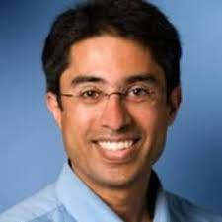





Industry Panel
Umesh Krishnaswamy
Brandon Schlinker
Chi-Yao Hong
12

Slide 13
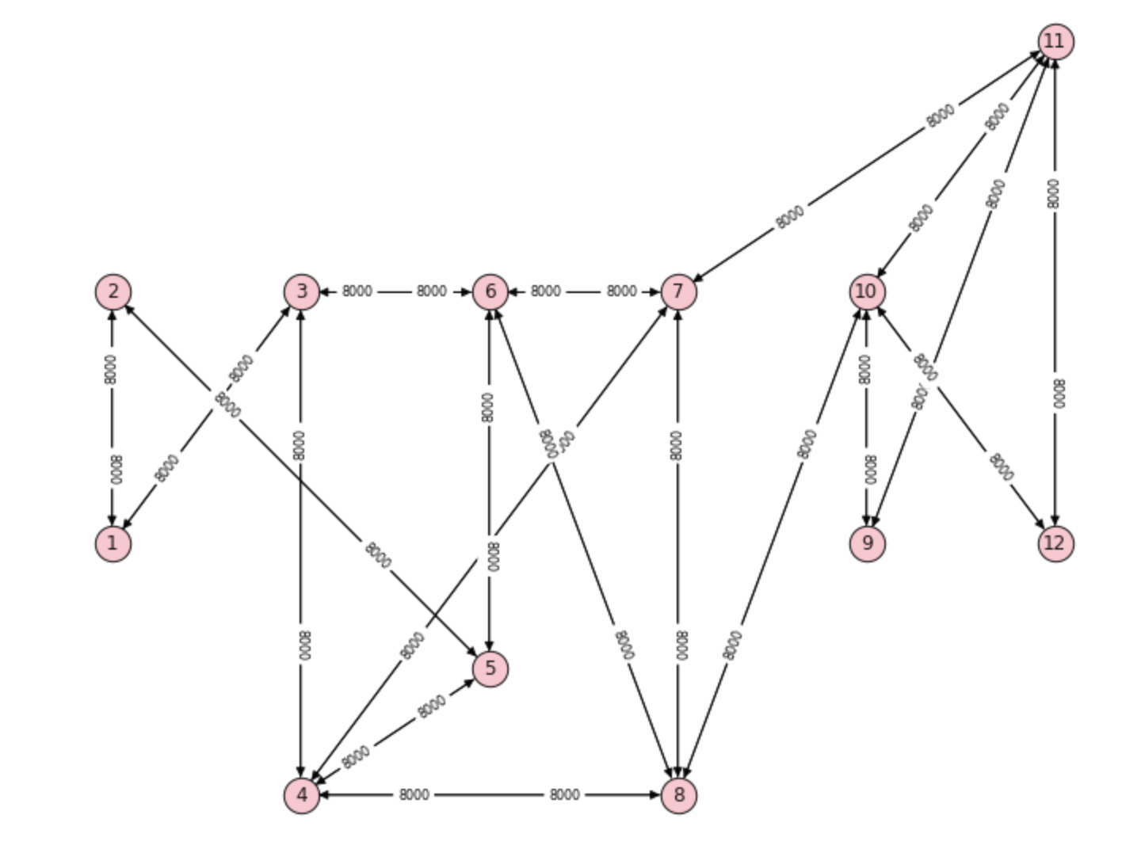
Hands-on programming session
2013
SWAN, B4
Centralized TE
2014
FFC
Failure Resilience
Network Topology
2016
2017
2018
2019
2021
Shoofly
Provisioning
13

Slide 14
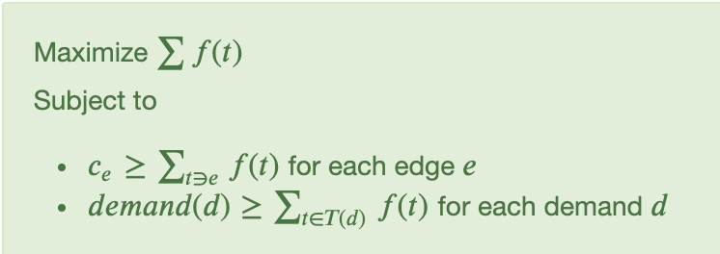
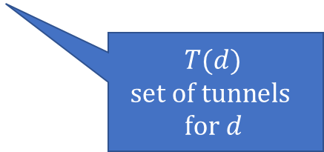
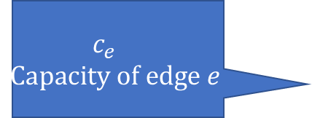
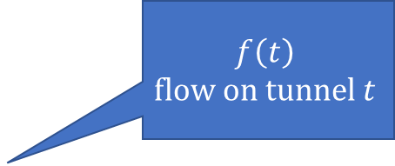
SWAN’s throughput maximization in a nutshell
$$f\left(t\right)$$
$$flow on tunnel t$$
$$c_{e}$$
$$Capacity of edge e$$
$$T(d)$$
$$set of tunnels$$
$$for d$$
14

Slide 15
Max. throughput with minimum latency a preview of more realistic objectives
15

Slide 16
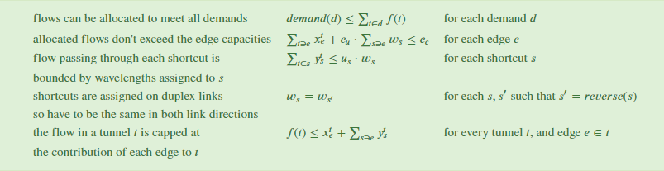
Capacity provisioning (Shoofly)
Provisioning objective is to allocate cost-effective capacity to enable flow to meet demand
details, details, …
16

Slide 17
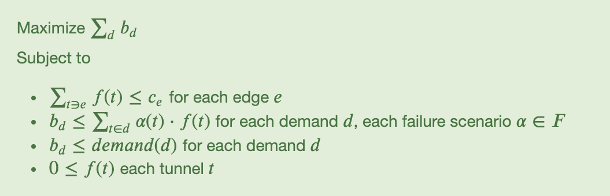
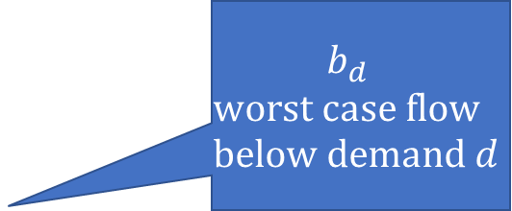
Failure resilience (FFC) Allocating flows for failure scenarios
$$b_{d}$$
$$worst case flow$$
$$below demand d$$
17

Slide 18
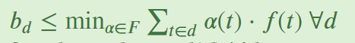
Efficient failure resilience
Linear Programming Duality
18

Slide 19
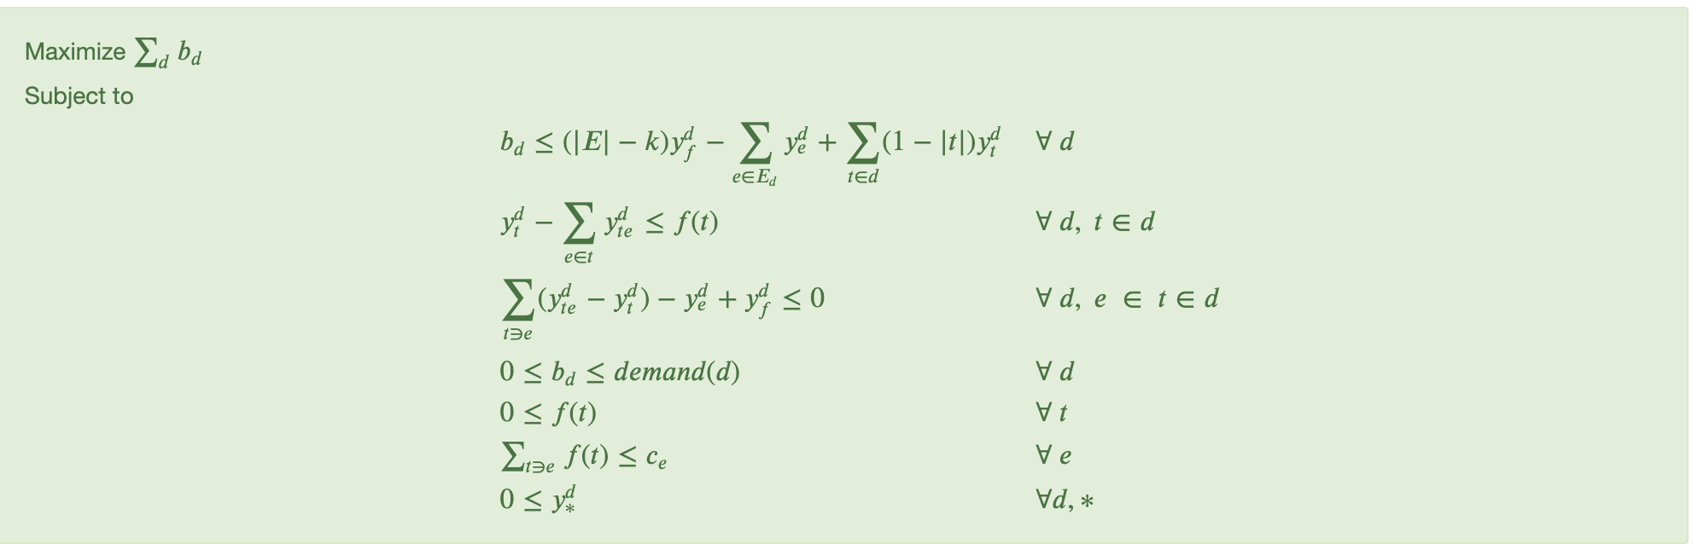
Efficient failure resilience details, details, …
19

